Slide 1
Robots building session

Slide 2
Different Pattern of LED Blinking.

Slide 3
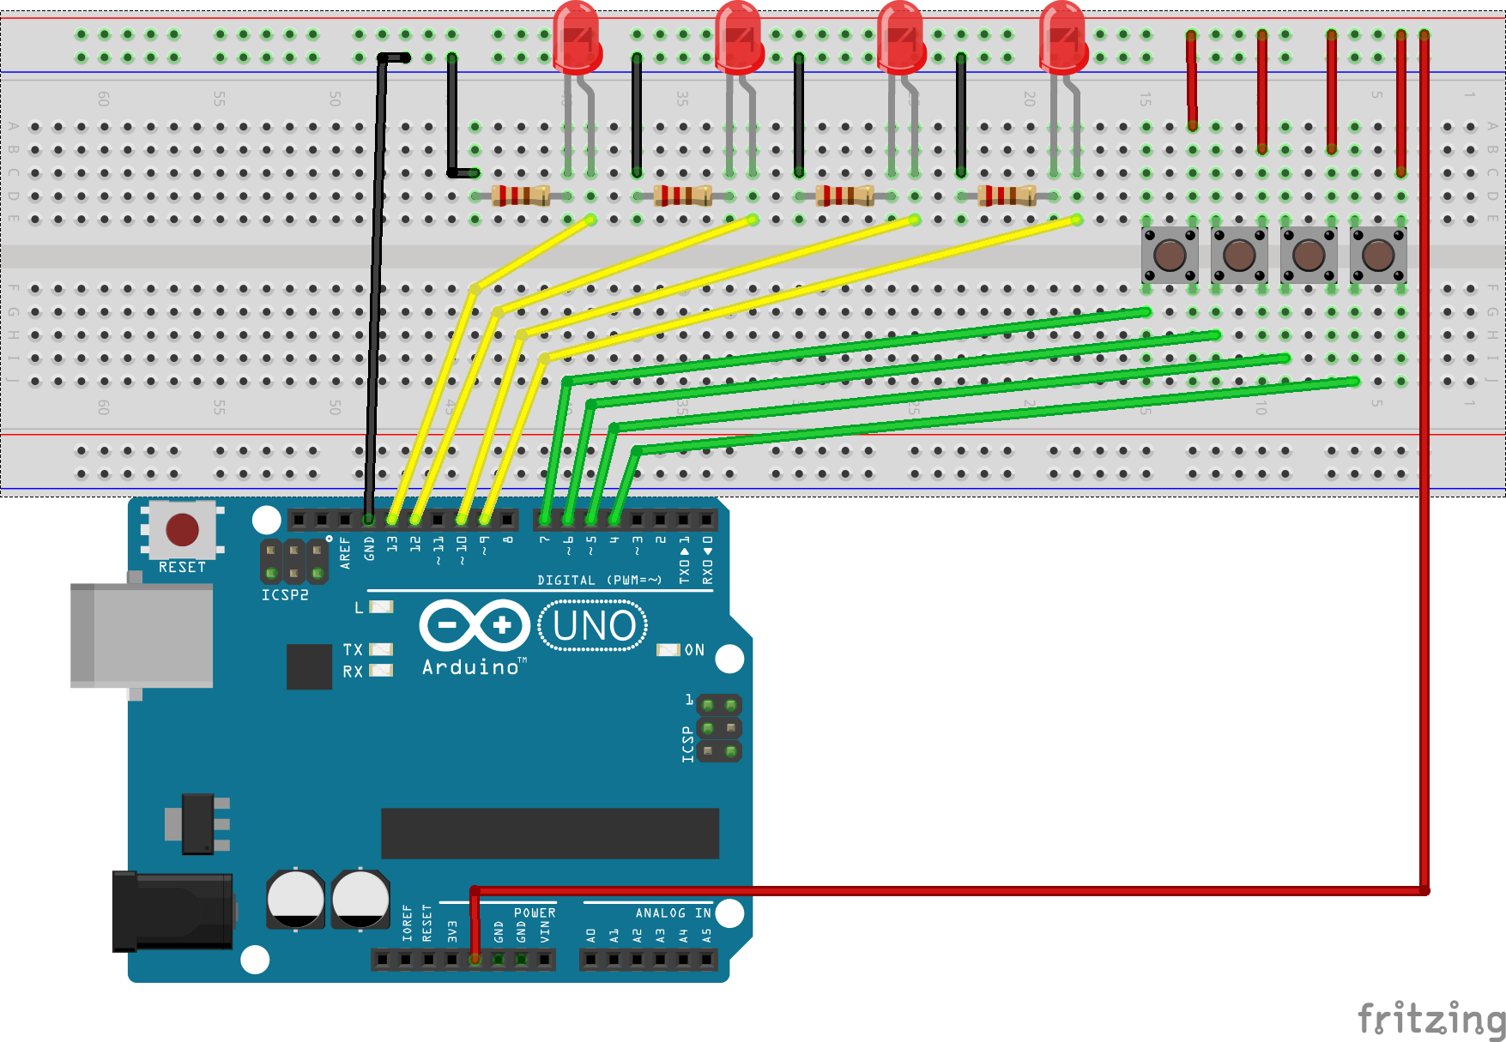

Slide 4
BLACK Line Follower Robot

Slide 5
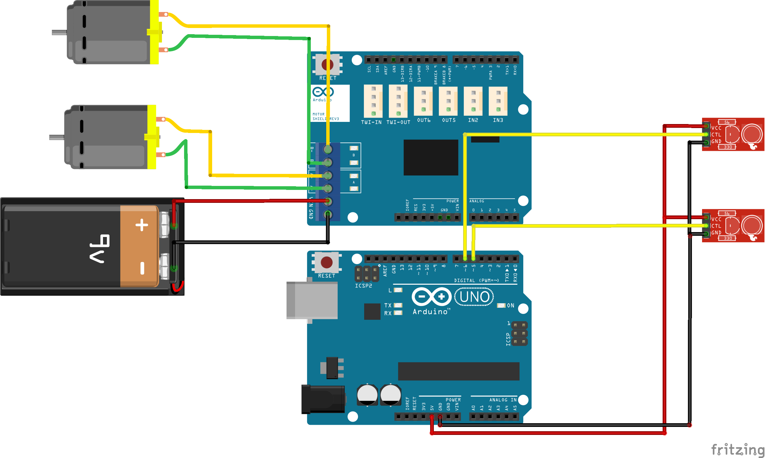

Slide 6
Obstacle Detector

Slide 7
MATERIAL REQUIRED
Arduino Uno.
Ultrasonic Range Finder Sensor – HC – SR04.
Motor Driver IC – L293D .
Geared Motors x 2.
Robot Chassis.
Caster wheel.
Jumper wires(M-F).
Power Supply.

Slide 8
WHAT IS AN OBSTACLE AVOIDING ROBOT?
It is an Autonomous robot.
Automatically sense and overcome obstacles on its path.
Uses a microcontroller and ultrasonic sensor(s).
Ultrasonic sensor works as eye for the robot for obstacle detection.
Microcontroller works as the brain of the robot.

Slide 9

No obstacle detected both the Wheels
are moving in forward direction
Obstacle detected both the Wheels
are moving in backward direction
OR
Robot will change its direction. Left wheel-backward
Right wheel-forward, robot will turn right.
Robot will change its direction. Left wheel-forward
Right wheel-backward, robot will turn right.

Slide 10
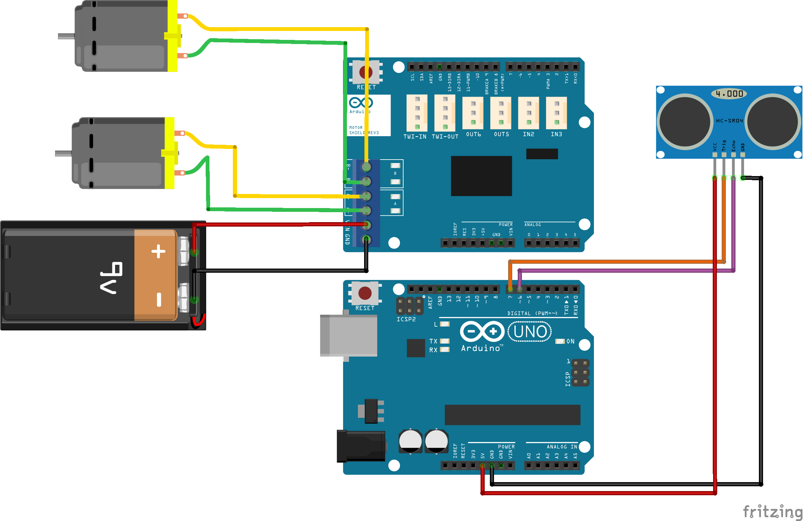

Slide 11
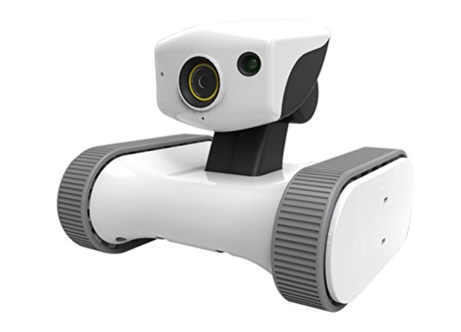
APPLICATION
Driverless vehicle.
Autonomous cleaning robot.
In Industries to pick and move materials from one place to another.
In search and rescue mission.

Slide 12
Wall follower

Slide 13
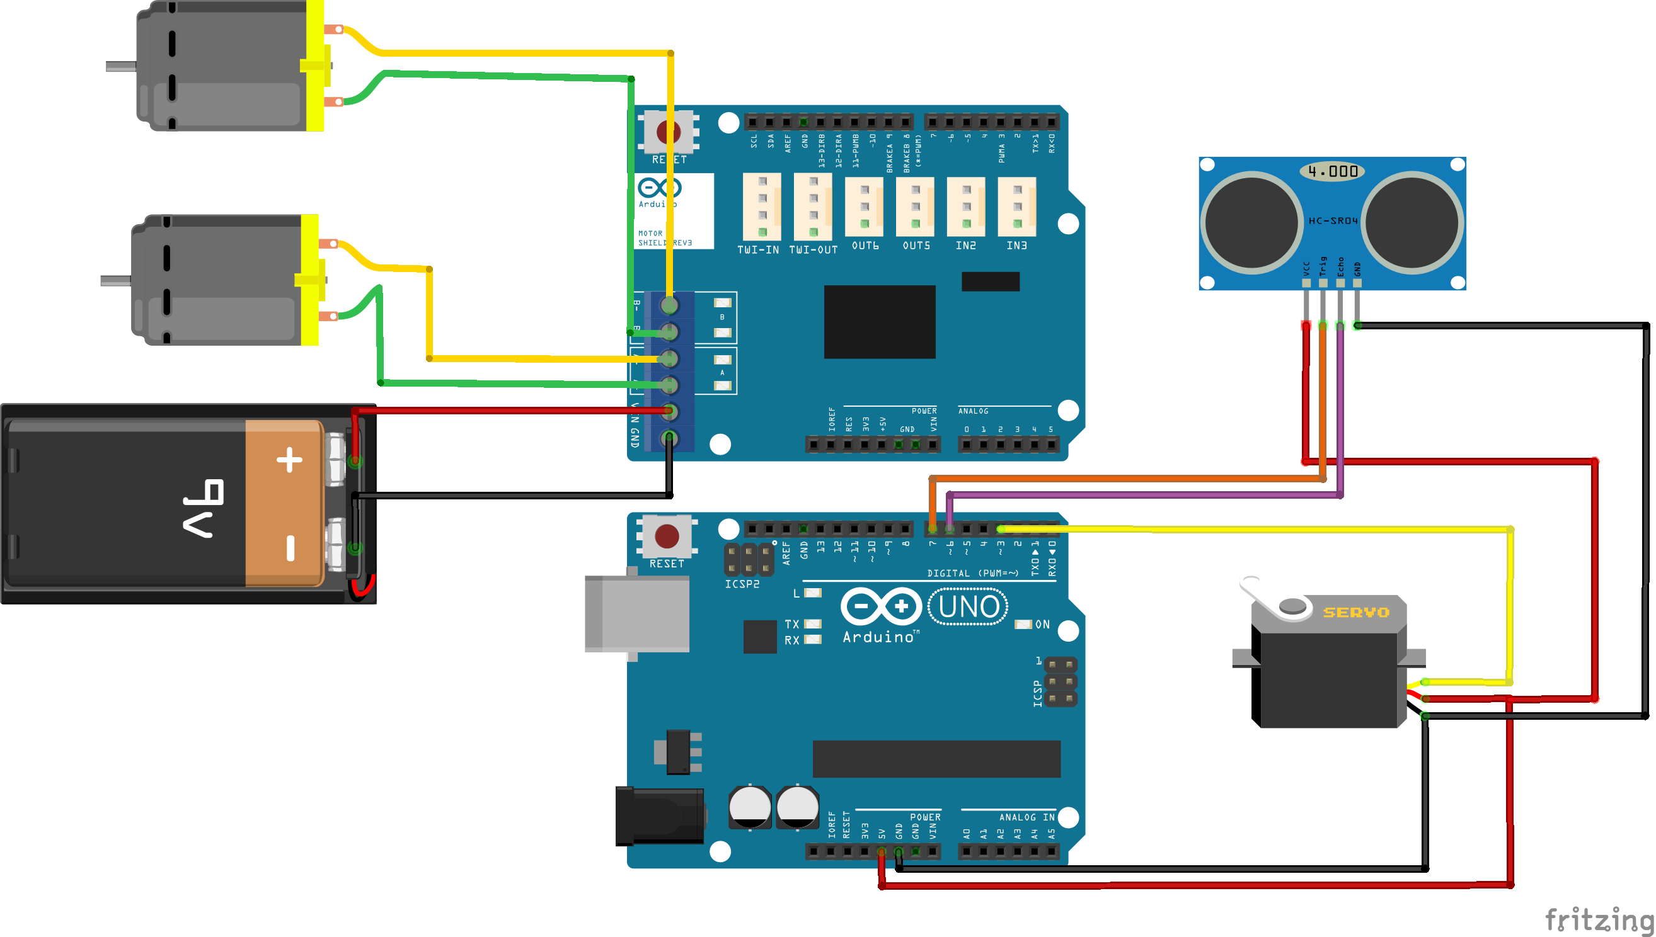

Slide 14
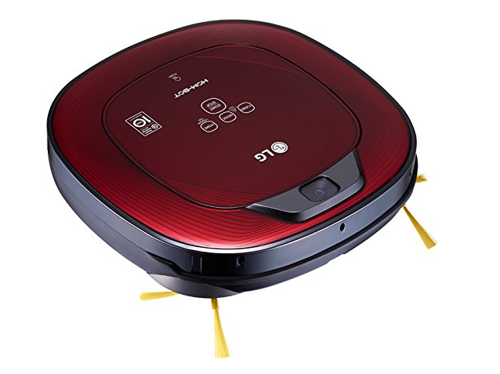
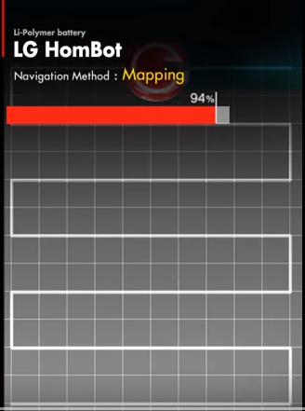
APPLICATION

Slide 15

THANK YOU

